Slide 1
FHIR Condition: Standardizing PHR Problem Lists and Clinical Diagnoses

Slide 2
Table of contents
01
02
03
04
What is FHIR condition?
FHIR condition might be used in the platform
Key elements of FHIR Condition
POC system demo
05
Action Items

Slide 3
01
What is FHIR Condition?

Slide 4
FHIR
FHIR (Fast Healthcare Interoperability Resources), a standard used to promote data exchange and interoperability in healthcare, provides a flexible, standardized approach to medical data exchange and sharing.
FHIR Resources Is the basic unit defined in the FHIR standard to describe various medical-related entities or information, including patients, doctors, drugs, and diagnoses.
FHIR Resources
Patient
Medication
Observation
Condition
Encounter
... ...

Slide 5

What is FHIR Condition?
FHIR (Fast Healthcare Interoperability Resources) Condition represents a patient's health status.
It can be used for:
Clinical diagnoses in hospitals
Personal health records (PHR) concerns
Social determinants of health (SDOH) issues
Perspective | FHIR Condition Represents | Examples
Clinical (Hospital) | Diagnosed medical conditions | Diabetes, Hypertension, Infections
Personal Health (PHR) | Self-reported health concerns | Anxiety, Stress, Obesity
Social Determinants (SDOH) | Social & environmental health risks | Poverty, Homelessness, Isolation

Slide 6
What is FHIR Condition?
Hospital Perspective (Clinical Condition / Diagnosis)
Used by hospitals and healthcare providers
Represents medically diagnosed conditions
Examples:
Diabetes Mellitus
Hypertension
Acute Respiratory Infection
Often linked with Encounter, Observation, MedicationRequest in FHIR

Slide 7
What is FHIR Condition?
Personal Health Perspective (PHR Problems)
Represents self-reported health concerns
May not be officially diagnosed but impact well-being
Examples:
Anxiety & Stress
Insomnia
Chronic Pain
Obesity
Helps individuals manage their own health proactively

Slide 8
What is FHIR Condition?
Social Determinants of Health (SDOH)
External factors affecting health and healthcare access
Often documented in FHIR Condition for public health & social care
Examples:
Economic Stability: Poverty, Unemployment
Housing & Environment: Homelessness, Air Pollution
Education: Low Literacy, Limited Health Knowledge
Social Support: Social Isolation, Domestic Violence

Slide 9
02
Key Elements of FHIR Condition

Slide 10

Key Elements of FHIR Condition
The FHIR Condition resource is used to record a patient's health conditions, diagnoses, diseases, injuries, or other clinical states.
It is essential for managing patient records, clinical decision-making, and healthcare data exchange.
The key elements of the FHIR Condition resource:
Identification & Status
Diagnosis & Classification
Subject & Recorder
Supporting Information

Slide 11
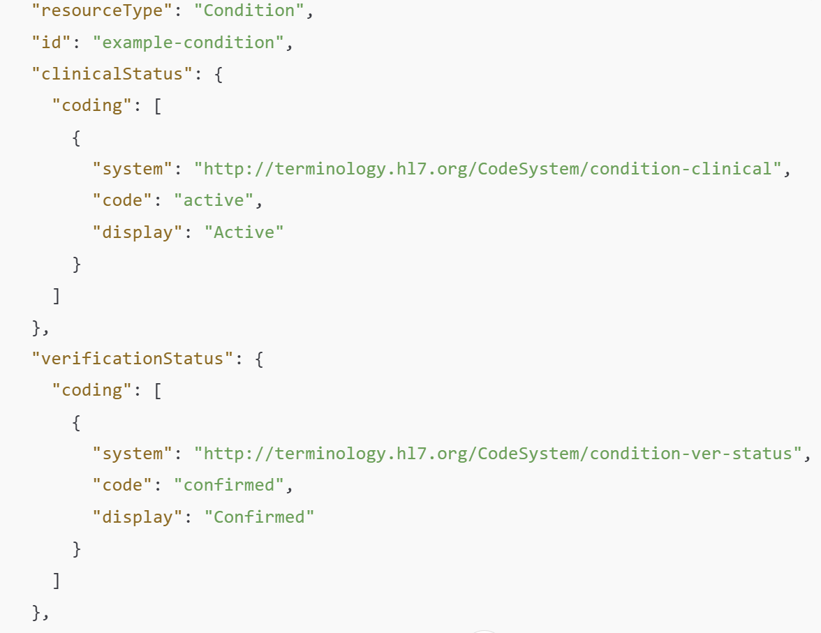
Key Elements of FHIR Condition
Identification & Status
id : Unique identifier for the Condition instance.
clinicalStatus : The current clinical state of the condition (e.g., active, recurrence, resolved ).
verificationStatus : Indicates whether the condition has been confirmed, is provisional, or is under investigation (e.g., confirmed, provisional, differential ).

Slide 12
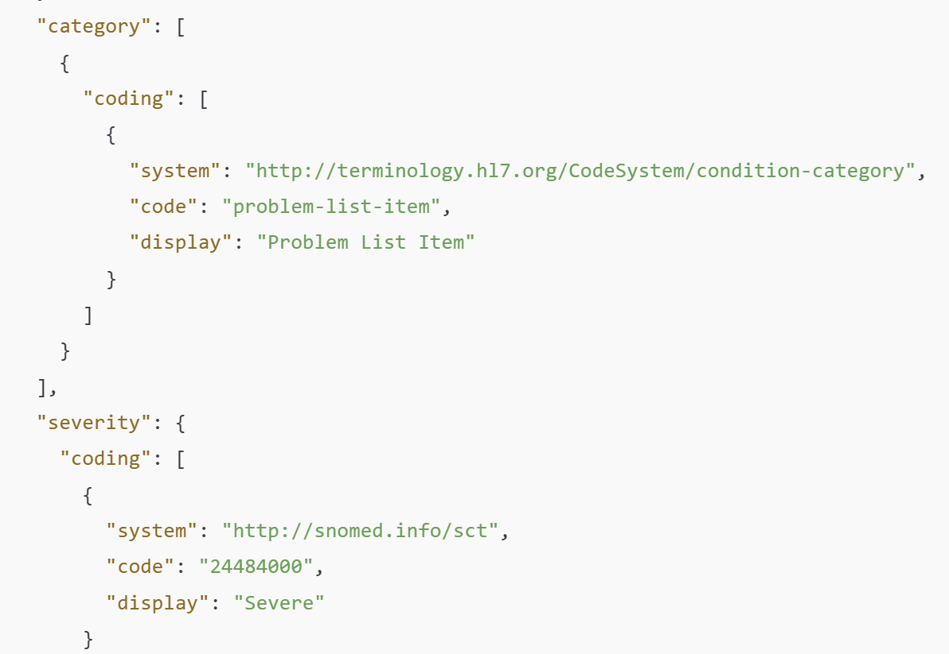
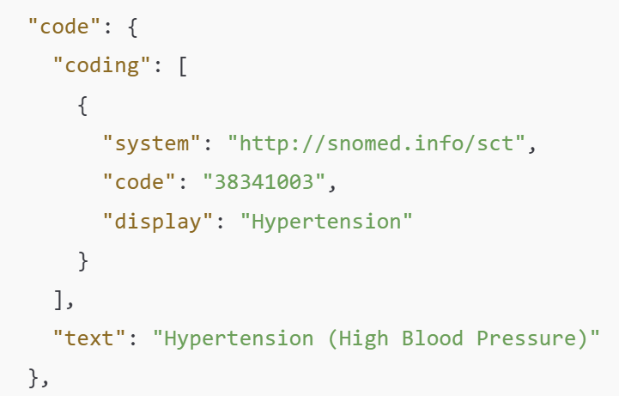
Key Elements of FHIR Condition
Diagnosis & Classification
code : The condition or diagnosis, typically coded using standard terminologies (e.g., ICD-10, SNOMED CT).
category : Classification of the condition, such as:
problem-list-item (A problem recorded in the patient's health record)
encounter-diagnosis (A diagnosis made during a clinical encounter)
severity : The severity of the condition (e.g., mild, moderate, severe ).
SNOMED CT Code
SNOMED CT Code

Slide 13
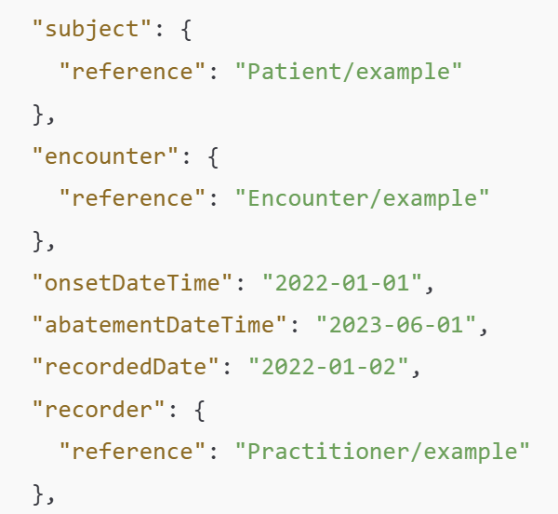
Key Elements of FHIR Condition
Subject & Recorder
subject : The patient or group affected by the condition (e.g., a Patient or Group).
encounter : The healthcare encounter during which the condition was recorded.
recordedDate : The date when the condition was recorded.
recorder : The person who documented the condition (e.g., a Practitioner ).

Slide 14
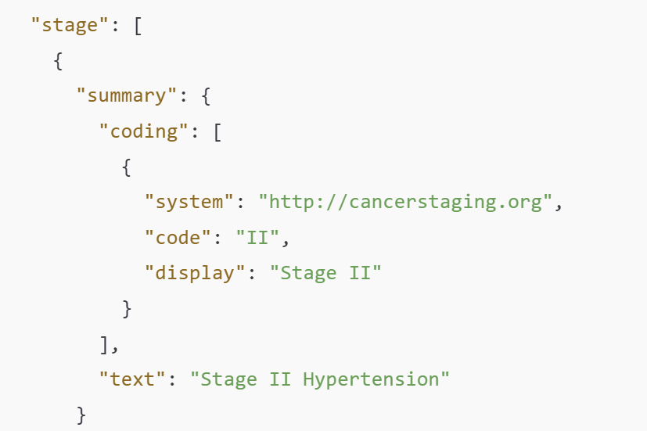
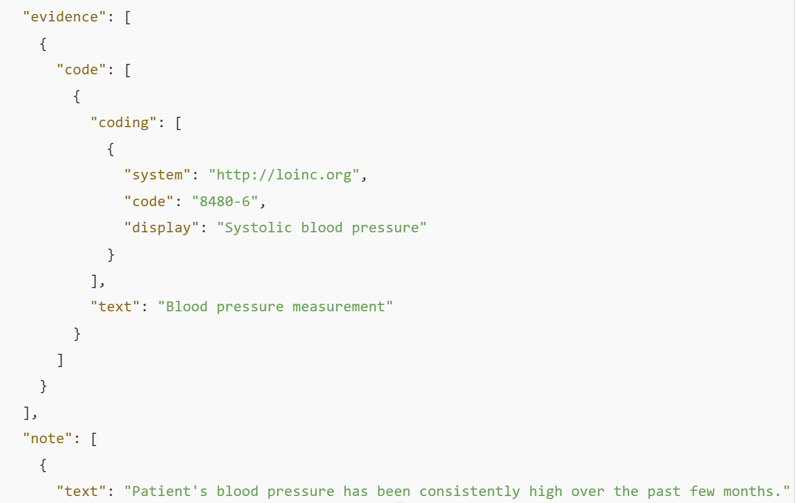
Key Elements of FHIR Condition
Supporting Information
stage : The stage or progression of the condition (e.g., cancer staging using TNM).
evidence : Supporting clinical evidence for the condition (e.g., lab test results, imaging findings).
note : Additional comments or observations about the condition.
Loinc Code 8480-6 (Systolic Blood Pressure)

Slide 15
03
FHIR condition might be used in the platform

Slide 16
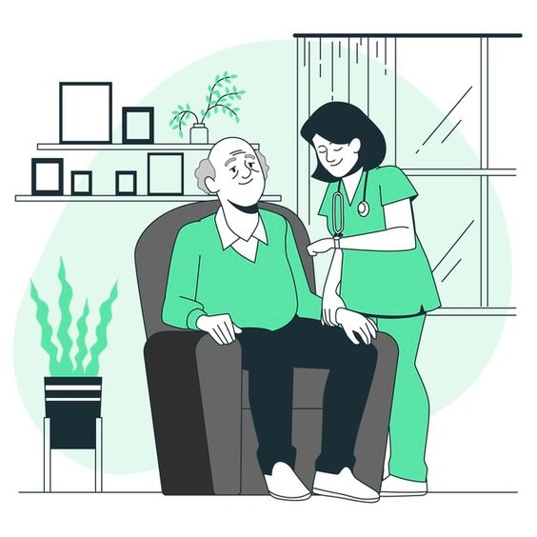


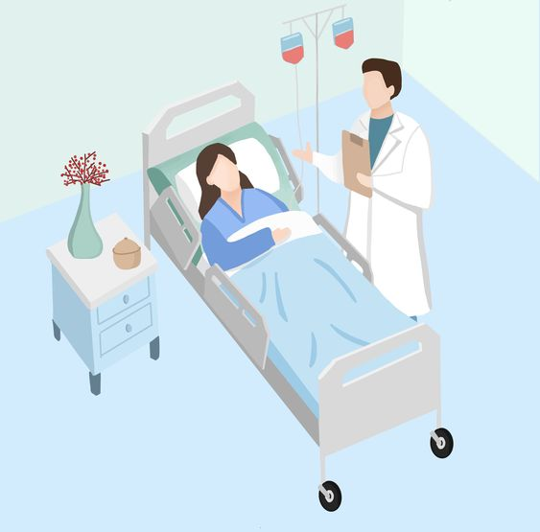
FHIR condition might be used in the platform
FHIR Condition resources can be used to record the patient's health status before medical treatment (Previsit), during medical treatment (Visit), and after medical treatment (Postvisit).

Slide 17

FHIR condition might be used in the platform
Previsit(Before the Medical Visit)
Chief Complaint (CC): Symptoms reported by the patient (e.g., headache, chest pain).
Chronic Conditions: Existing conditions such as hypertension or diabetes.
Family History: Relevant diseases in the family.
Past Medical History (PMH): Resolved conditions (e.g., past stroke).
Differential Diagnosis (DDx): Initial suspected conditions (marked as provisional).

Slide 18

FHIR condition might be used in the platform
Visit (During the Medical Encounter)
Confirmed Diagnoses: Finalized diagnosis after clinical assessment.
Complications: Conditions arising from existing diseases (e.g., diabetic foot).
In-Hospital Conditions:
Hospital-acquired infections.
ICU-related conditions (e.g., sepsis, ARDS).
Surgical Diagnoses:
Preoperative conditions (e.g., gallstones).
Postoperative findings (e.g., unexpected tumor).

Slide 19

FHIR condition might be used in the platform
Postvisit (After the Medical Visit)
Follow-up Conditions: Ongoing monitoring needs (e.g., post-pneumonia recovery).
Chronic Disease Management: Continued treatment for conditions like hypertension.
Sequelae (Long-term Effects): Conditions resulting from past diseases (e.g., post-stroke hemiplegia).
Recovery Status: Healing progress (e.g., post-surgery recovery).
New Complications: Late-stage issues (e.g., post-surgical infection).

Slide 20
FHIR condition might be used in the platform
Key FHIR Condition Attributes
Attribute | Description | Example
category | Type of condition | encounter-diagnosis, problem-list-item
clinicalStatus | Current state | active, remission, resolved
verificationStatus | Diagnosis certainty | provisional, confirmed, differential
onsetDateTime | Start time of condition | 2024-03-01T12:00:00Z
abatementDateTime | End time if resolved | 2024-03-10T12:00:00Z
evidence | Supporting data | Observation, ImagingStudy

Slide 21
04
POC system demo

Slide 22
05
Action Items

Slide 23
Action Items
PHR Condition Requirements
Identify user needs for managing health records.
Data input, access, and sharing capabilities.
Support for multiple languages ​​(e.g., English, Chinese, Taiwanese, Indonesian).
Functionality requirements: Users can upload and view their medical records, allergy history, medication lists, etc.
Language support: The user interface must be available in Chinese, French and German.

Slide 24
Action Items
SDOH Condition Requirements
Requirements Analysis & Functional Specifications
Data Standardization
Internationalization
Data collection: The system needs to be able to collect information such as shared residential address, income level, educational background, etc.
Main functions: Provide tools to analyze these social factors and ultimately affect the user's health status, and generate reports.

Slide 25

Interesting group participant recruitment
General Volunteers
Doctors or students interested in medicine

Slide 26
Thanks!

Slide 27
01
Basic concept introduction
What is a FHIR Condition?

Slide 28
FHIR
FHIR (Fast Healthcare Interoperability Resources), a standard used to promote data exchange and interoperability in healthcare, provides a flexible, standardized approach to medical data exchange and sharing.
FHIR Resources Is the basic unit defined in the FHIR standard to describe various medical-related entities or information, including patients, doctors, drugs, and diagnoses.
FHIR Resources
Patient
Medication
Observation
Condition
Encounter
... ...

Slide 29
FHIR Condition
FHIR Condition It refers to the patients medical diagnosis or the health problem.
Conditions It can be a wide variety of diseases, symptoms, disorders or other medical problems, such as diabetes, high blood pressure, colds, headache, etc.
It usually contains detailed information about the disease or problem, including the date of diagnosis, severity, diagnosis, etc.

Slide 30
02
FHIR CONDITION Structure and classification
FHIR Condition What parts are made up of?

Slide 31
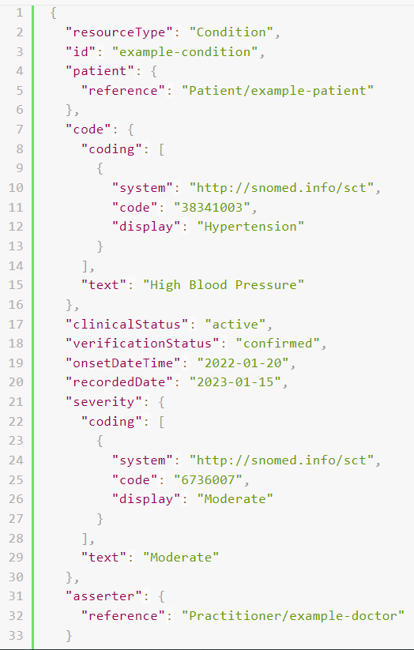
FHIR Condition Structure
example:
Indicates the clinical status
disease time
Patient data
clock
order of severity
Coding information of diseases
Doctor information

Slide 32
FHIR Condition Classification
Medical professionals of medical professionals (clinical diganosis)
Problem status stated by the individual or caregiver (PHR condiction)
Life issues that may affect health (social determinants of health: SDOH)

Slide 33
03
FHIR + PHR / EMR
PHR FHIR Conditon

Slide 34
PHR FHIR condition
PHR (Personal Health Record, personal health record) refers to the electronic record of medical and health information maintained by the individual, which can contain information about the individuals medical history, diagnosis, treatment plan and so on.
Why to apply the FHIR Condition to the PHR?
Transmission and interoperability: Personal health records can be interacted with and shared with a healthcare providers system.
Improving the quality of doctor-patient communication: This helps patients better manage their health information, easily share information with healthcare providers, and get better care when needed.

Slide 35

EMR FHIR condition
The EMR (Electronic Medical Record) is usually deployed and maintained by healthcare facilities to document and manage patient information from healthcare providers, including medical records, diagnoses, prescriptions, laboratory results, etc.
EMR
PHR
Depth of the diagnostic record
deagnostic code
Clinical details
Simplified records
self-report
Lifestyle and preventive measures

Slide 36
The PHR application context
live with ones own family
long distance
See the doctor
ward
input mode:
Web page or the APP interface
Voice interaction: many languages (Mandarin, Taiwanese...）

Slide 37
To alleviate the problems of the people
Provide a quiet and comfortable environment: ensure that the patient is in a quiet, comfortable environment and reduce stimulation and interference.
Provide an appropriate diet: provide an appropriate diet according to the symptoms and avoid stimulating foods and drinks.
Give drug help: give appropriate drugs as needed, such as antipyretic drugs, painkillers, etc. Please make sure to read the instructions carefully before using the drug.
Monitoring the symptoms: Regularly monitor the patient&#039;s symptoms and conditions. If the symptoms worsen or persist for too long, seek medical attention promptly.
Provide psychological support: give patients emotional support and comfort to help them tide over difficulties.

Slide 38
The mainly treated FHIR Resource
The PHR side: a personal health record
Patient (Patient): Record basic personal information, such as name, gender, date of birth, etc.
Condition (Health issues): Record the individual&#039;s medical diagnosis or health issues, such as diseases, symptoms, etc.
Observation (Observation results): Record personal physical signs or other measurements, such as blood pressure, blood sugar, etc.
Medication (Drugs): Record personal drug information, including prescription drugs, over-the-counter drugs, supplements, etc.
Practitioner (Medical provider): Record the information of individual medical providers, such as doctors, nurses, etc.
EMR side: electronic medical records of medical institutions
Patient (Patient): Record the basic information of the patient, such as his name, gender, date of birth, etc.
Condition (Health issues): Record the patients medical diagnosis or health problem.
Observation (Observations): Record various laboratory tests, physical observations or other measurements.
Medication (Drug): Record the patient informations drugs, including prescription drugs, non-prescription drugs, etc.
Encounter (Visit): Record the medical treatment of patients, including the visit time, visit type, etc.

Slide 39
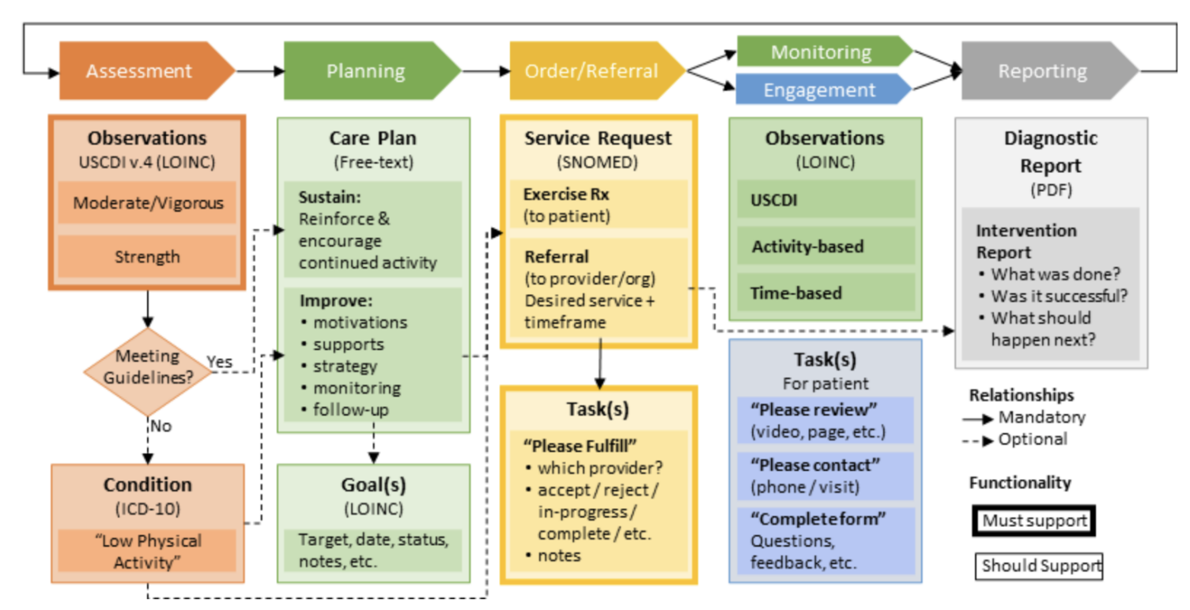
Routine medical process

Slide 40
To alleviate the problems of the people
Public problems: such as cough, runny nose, stomachache and so on
PHR Conditions And its further differentiation (disease type, severity...）
Home or community mitigation and monitoring and tracking
Inspection and medical treatment
Provide personalized and localized mitigation solutions
Based on personal physical constitution, disease, physical condition
Based on the geochemical scheme, such as ginger soup to remove the cold

Slide 41
04
Future Expectations

Slide 42
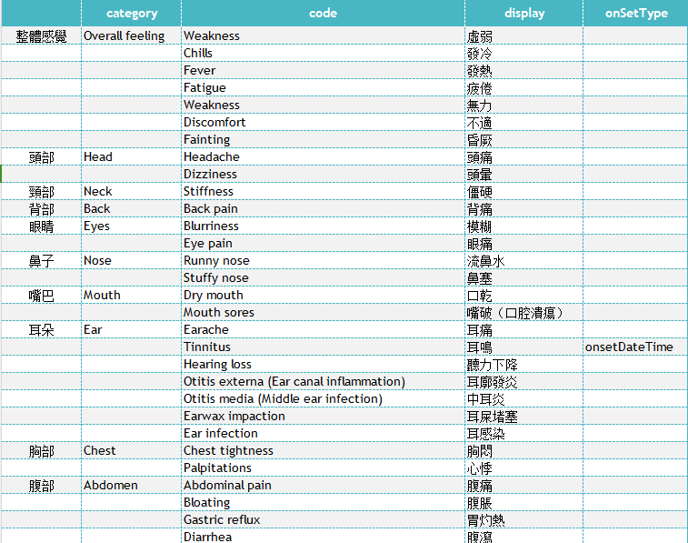
Development needs
There is no current example of the problem status (PHR condiction) stated by individuals or caregivers.
Sorout common problems
To treat certain diseases or treatments, organize common problems
Extension discussion and arrangement, the public end condition solution

Slide 43
Development needs
System integration of medical, service, and public terminals:
Medical side: to provide accurate assessment and disposal advice
Service side: to provide high-quality services and incentives
Public side: follow the exercise prescription, physiological and problem status response, immediate interaction
PHR end and EMR end integration are required to make accurate assessments and suggestions, and provide immediate services and medical interaction.

